Slide 1
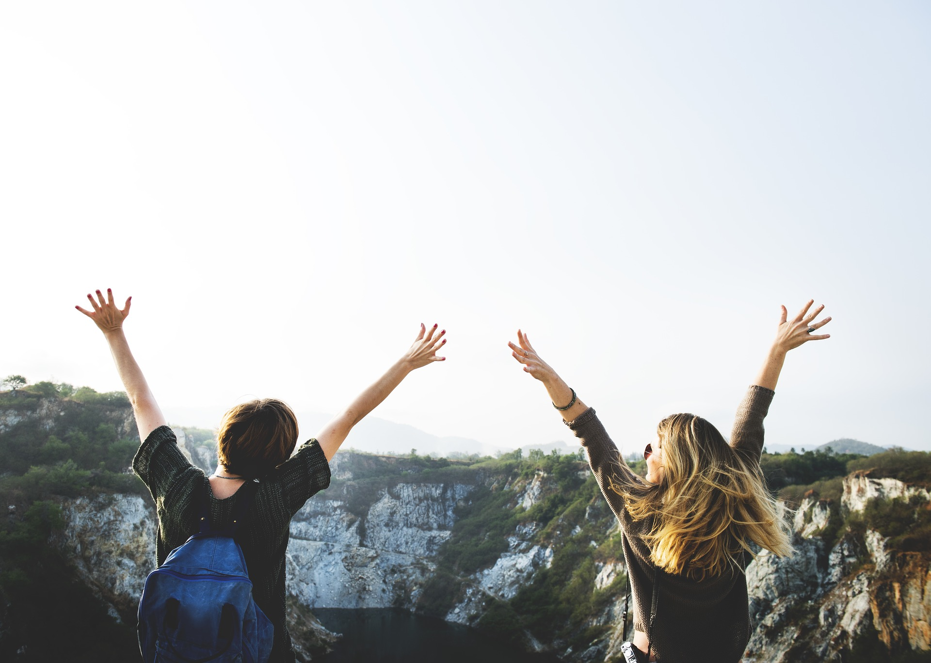
Notes:
Share the history of Bounce Back Project (see BBP Beginnings in training manual) – started in 2015 in Wright County, MN after the loss of 2 local physicians…

Slide 2
What is Bounce Back
Project?
Unique collaborative of physicians, nurses, healthcare leaders and community members
Single purpose – to impact the lives of individuals, communities, and organizations by promoting health through happiness
Notes:
What?

Slide 3
Bounce Back Project Tools
Purpose: to expand resilience by retraining our mind to focus on the positive, increase the feelings of well-being and decrease the feelings of depression
Random Acts of Kindness
Three Good Things
Gratitude
Social Connections
Mindfulness and Self-Care
Purpose
Notes:
Why and How?

Slide 4
Random Acts of Kindness
Notes:
This is the first tool that Bounce Back Project kicked off in our local communities. We figured it was a great place to start – something that many people were familiar with and had been doing for a long time.
Most of us do a Random Act of Kindness because it can help make the other person’s day better…in fact it increases their happiness for up to 24 hours! But what you may not be aware of is that when you do a Random Act of Kindness for someone, your own happiness increases for up to 2 weeks! It’s a Win-Win! What a great way to keep your resilience at it’s best.

Slide 5
Random Acts of Kindness
Doing an act of kindness produces the single most reliable momentary increase in well-being of any exercise that has been tested.
Dr. Martin Seligman
University of Pennsylvania
Notes:
People do all types of activities like running, playing tennis, yoga, lifting weights, etc. to keep their physical bodies healthy. But doing a Random Act of Kindness is essential to keeping our mental and emotional health at it’s best.

Slide 6
Random Acts of Kindness
“Life is an echo.
What you send out, comes back.
What you sow, you reap.
What you give, you get.
What you see in others, exists in you.”
- Zig Ziglar
Notes:
Seeing a RAK Increases the kindness of others. When we are generous, it increases the generosity of others.
It also Affirms our belief in human nature. We see the goodness that is possible in each other. It can create what Abraham Maslow describes as a “peak experience” where we feel “awe, wonder and a sense of ‘rightness’ which makes us feel immensely grateful to be alive” (Taylor, 2013, para. 4).

Slide 7
Happiness and Random Acts of Kindness
There are two good things in life
– freedom of thought and freedom of action.
W. Somerset Maugham
Notes:
We are the ones who are in control of how we think and how we act, right? We can decide if we want to think of the good things that happen in our day and that we will act in a positive way, a way that brings happiness to ourselves and others.

Slide 8
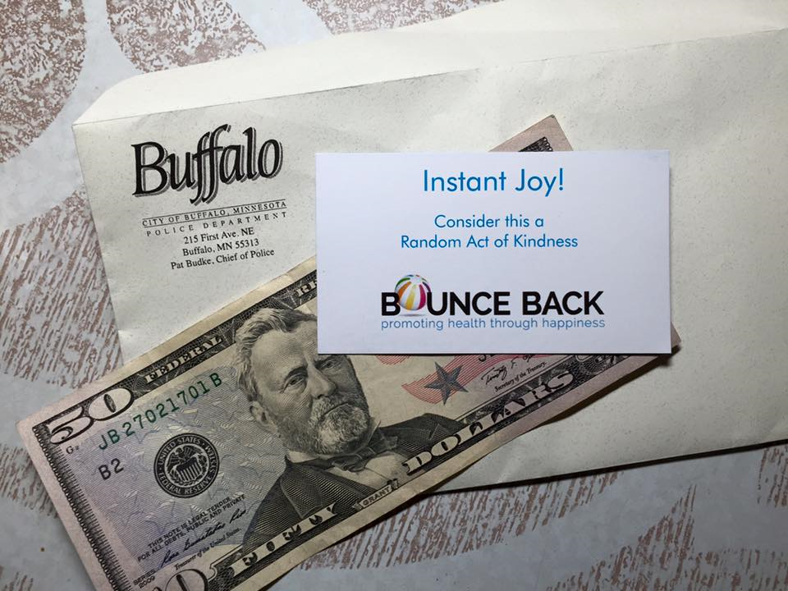
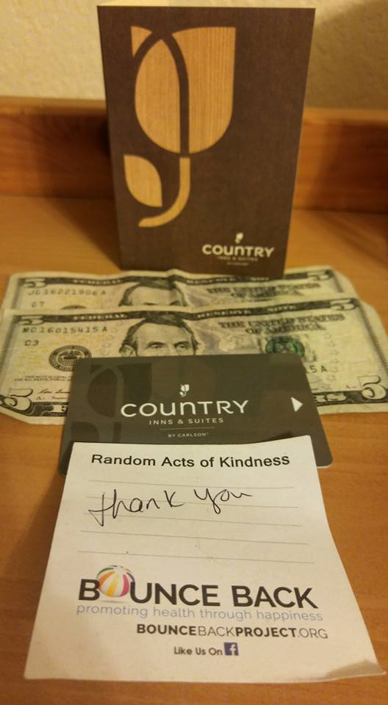
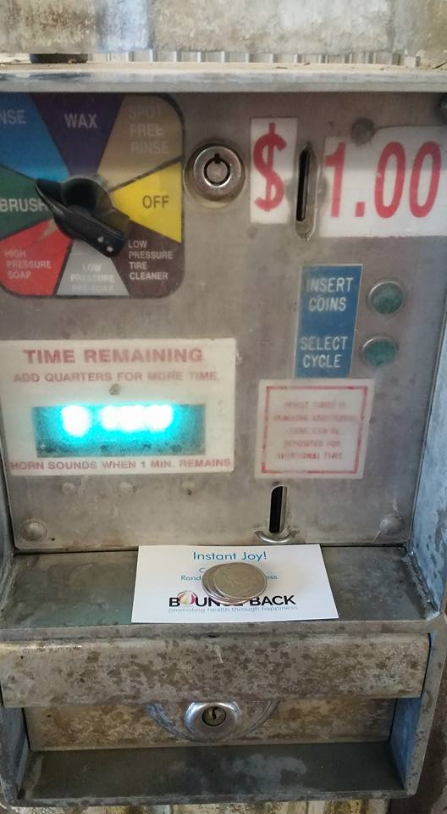
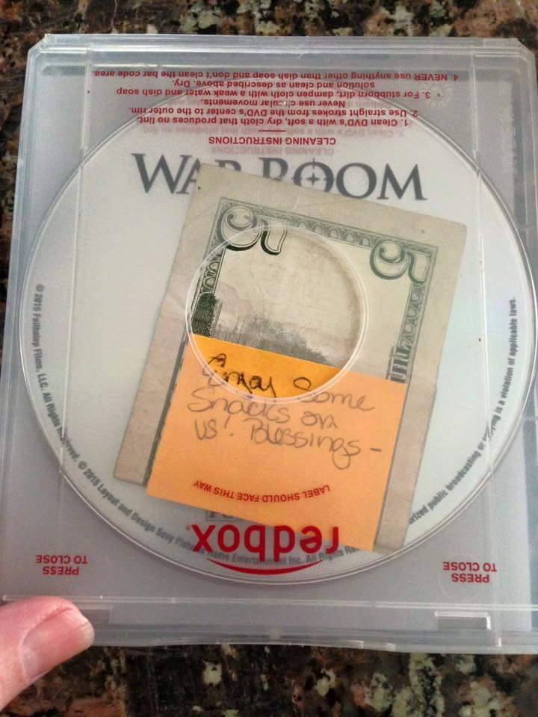
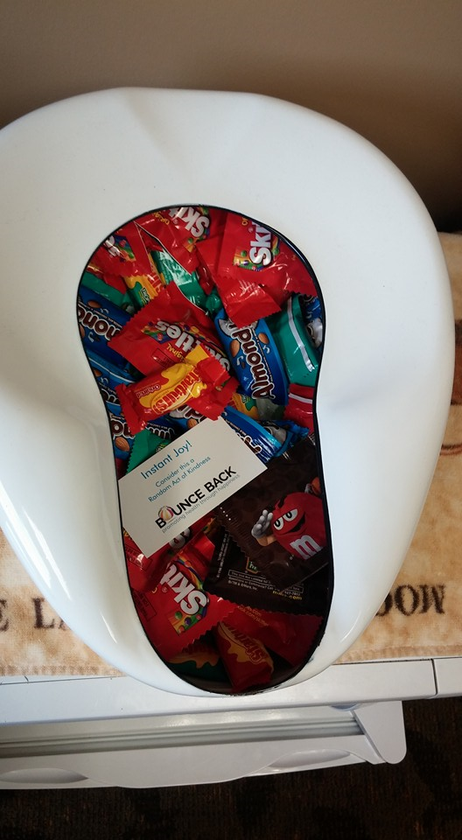
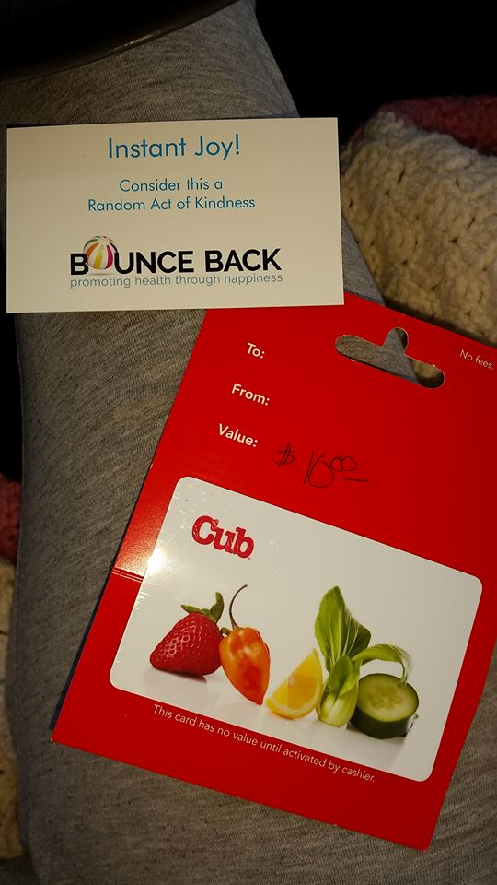
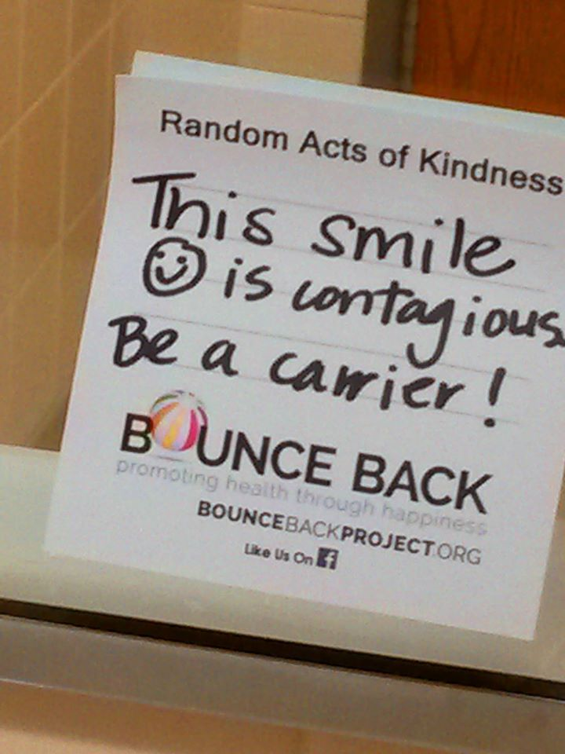
Random Acts of Kindness
What have you seen? What have you done?
Notes:
I’ve seen the kids in our community embrace RAKs and do multiple things around town…pick up garbage, do projects with residents of the nursing home, raise money for gift cards, chalk the sidewalks with great motivational sayings. We’ve seen people leave money at the laundromat for a free wash, money in the redbox for free snacks, etc.

Slide 9
Impact On Bystanders (what will your random act of kindness do to those who witness?)
Increases kindness in others
Increases generosity in others
Creates a “peak experience” of gratitude and ability to be content with current state
Change For A Dollar
Notes:
Elation: The Amazing Effect of Witnessing Acts of Kindness | Psychology Today

Slide 10
RAOK in Your Life
Do RAOK regularly
Give workplace incentives for doing a RAOK
As a group, complete a RAOK in the community
Create a “challenge” for a variety of work groups to complete RAOKs

Slide 11
Want to Become Part of the Movement? Text bounceback to: 833-956-0928 Like us on Facebook: Bounce Back Project Check out our web pages: www.bouncebackproject.org Sign up for newsletter: https://bit.ly/3wVS3zo

