Slide 1



Notes:
Share the history of Bounce Back Project (see BBP Beginnings in raining manual) – started in 2015 in Wright County, MN after the loss of 2 local physicians…

Slide 2

What is Bounce Back Project?
Unique collaborative of physicians, nurses, healthcare leaders and community members
Single purpose – to impact the lives of individuals, communities, and organizations by promoting health through happiness
Notes:
What/

Slide 3
Bounce Back Project Tools
Purpose: to expand resilience by retraining our mind to focus on the positive, increase the feelings of well-being and decrease the feelings of depression
Random Acts of Kindness
Three Good Things
Gratitude
Social Connections
Mindfulness and Self-Care
Purpose
Notes:
Why and How?

Slide 4
Resilience
Notes:
First let’s find out what is resilience?

Slide 5
Resilience
Resilience: re·sil·ience /rəˈzilyəns/
noun
1. the ability of a substance or object to spring back into shape; elasticity.
2. the capacity to recover quickly from difficulties; toughness.
Notes:
I like to compare this to a large rubber band that you stretch between your two hands. You can only stretch it so far before it will finally “snap”. Well, we as human beings are very much like the rubber band…we can only take so much before we to night “snap”!

Slide 6
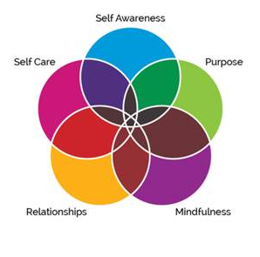
Five Pillars of Resilience
Notes:
These 5 pillars really build the foundation of the resilience tools that BBP shares. Discuss each pillar briefly: Bounce Back Project™ | Promoting Health Through Happiness

Slide 7

Resilience can be learned!
Consistency is the key
The more you practice the better you get
Strive for progress, not perfection
Notes:
The best part about resilience is that we can all learn to be better at it! For many years, it was thought that you were either born with resilience or not. Right? We all know someone who handles all the bad things that happen in their lives with grace and do really well - and then there are others who cannot handle sitting at a red light too long. Some of us are “cup half full” kind of people while others see life through the “cup half empty” kind of lens. We can all strive to get better at learning ways to become more resilient.
Teaching resilience in the classroom and books for resilience:
https://positivepsychology.com/teaching-resilience/
https://positivepsychology.com/resilience-activities-worksheets/
https://www.weareteachers.com/8-ways-to-help-your-students-build-resiliency/
https://biglifejournal.com/blogs/blog/top-childrens-books-resilience

Slide 8
Why Is Resilience So Important?
Greater resilience leads to improved learning and academic achievement.
Resilience is related to lower absences from work or school due to sickness.
It contributes to reduced risk-taking behaviors including excessive drinking, smoking, and use of drugs.
Those with greater resilience tend to be more involved in the community and/or family activities.
Higher resilience is related to a lower rate of mortality and increased physical health
Notes:
Blog by Joshua Miles BACP Accredited Psychotherapist, listed counsellor/therapist

Slide 9

Resilience can add years to your life….
I’m going to make you all live 7.6 minutes longer by what we do today.
Notes:
Let’s all do a few quick activities together that help us to gain a few extra minutes in our lives by building our resilience. (next 4 slides)
Source: “I’m a gamer,” said Jane McGonigal in her TEDTalk. “So I like to have goals, like special missions, and secret objectives,” she added. “So here’s my special mission for this talk. I’m gonna try to increase the life span of every reasonable person in this room by 7 1/2 minutes.” Jane McGonigal, is a game designer, has a Ph.D. from Berkeley, author of Reality is Broken, and has researched the psychology of games for over a decade. She makes a bold
statement on the TED stage in her talk, “The game that can give you 10 extra years of life.”
In an audacious move by McGonigal claiming to increase the lifespan of her audience, McGonigal , for demonstration purposes, gave the audience simple challenges to boost four types of resilience — physical, mental, emotional and social; which in turn will add 7 1/2 minutes to their life, she said. And McGonigal concludes that “people who regularly boost these four types of resilience — physical, mental, emotional, and social live 10 years longer than everyone else.”

Slide 10
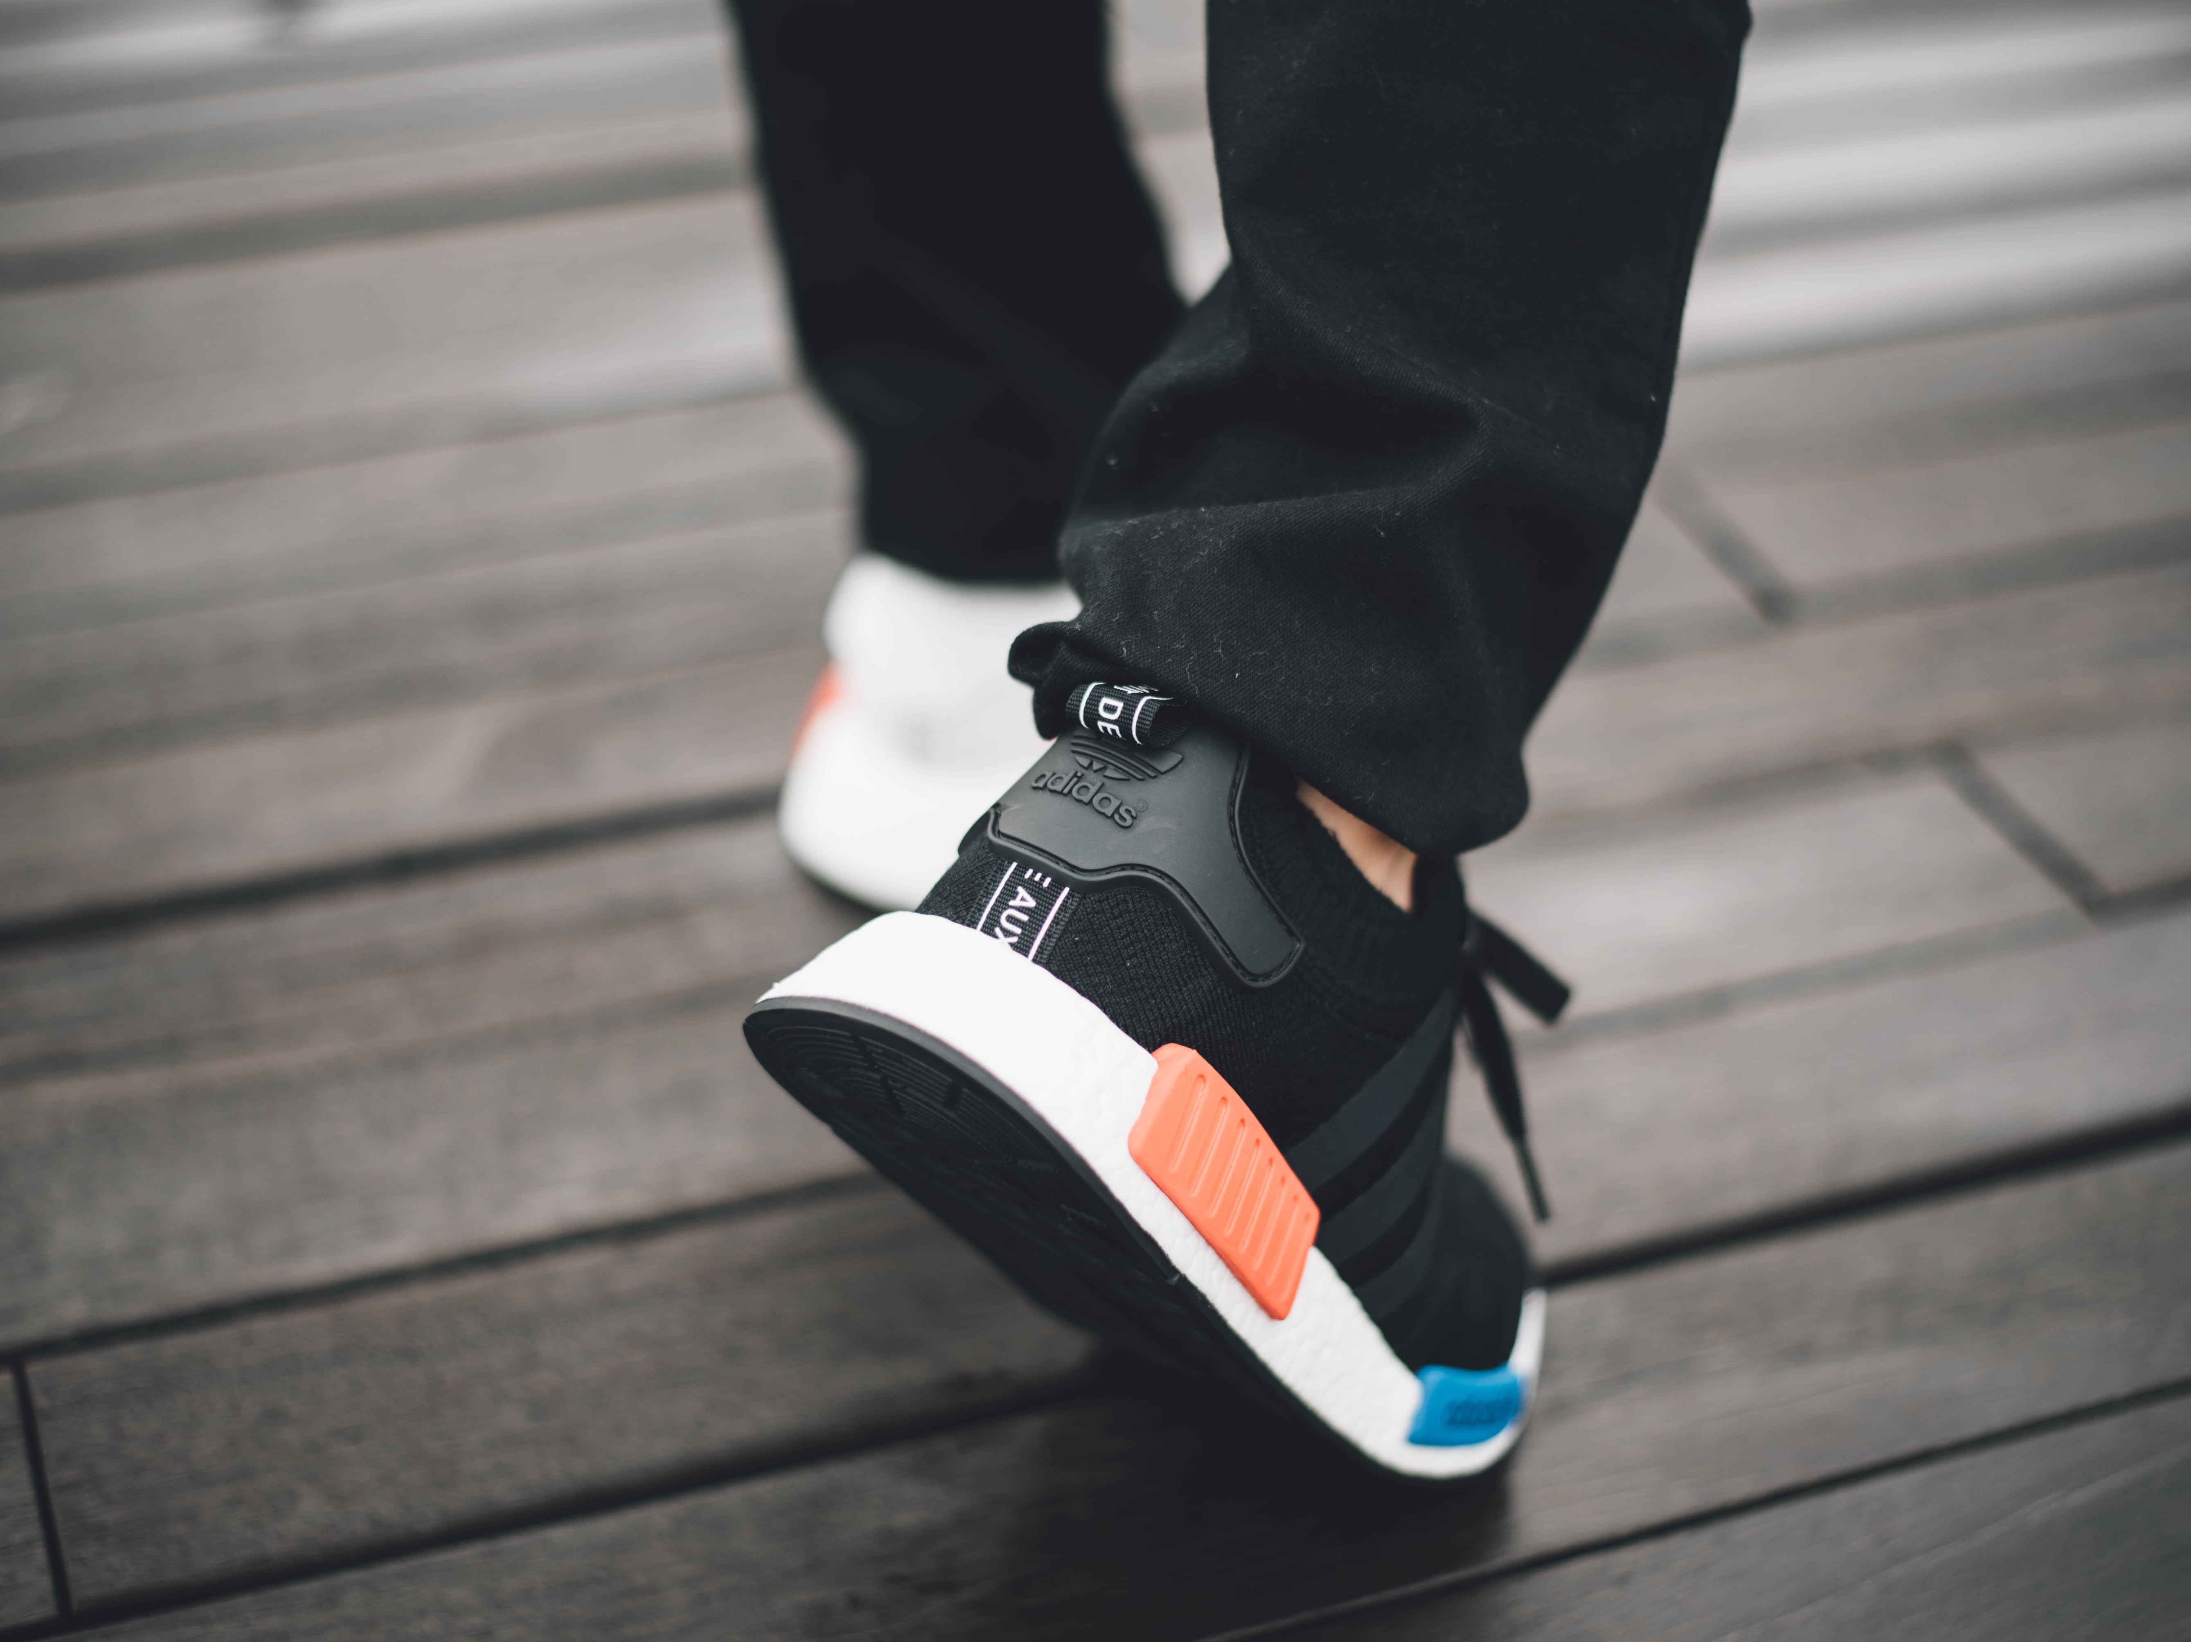
Physical
Resilience
1. Stand up and take ten steps in place
Notes:
Well done, everyone. That has just improved your physical resilience, which means that your body can withstand more stress and heal itself faster. We know from the research that the number one thing you can do to boost your physical resilience is to not sit still. That's all it takes. Every single second that you are not sitting still, you are actively improving the health of your heart, and your lungs and brains.

Slide 11

Mental
Resilience
2. Snap your fingers EXACTLY 30 times
Notes:
Well done, everyone. Now that was working on your mental resilience, which means you have more mental focus, more discipline, determination and will power. We know from the scientific research that willpower actually works like a muscle. It gets stronger the more you exercise it. So tackling a tiny challenge without giving up, even one as absurd as snapping your fingers exactly 30 times is actually a scientifically validated way to boost your willpower.

Slide 12
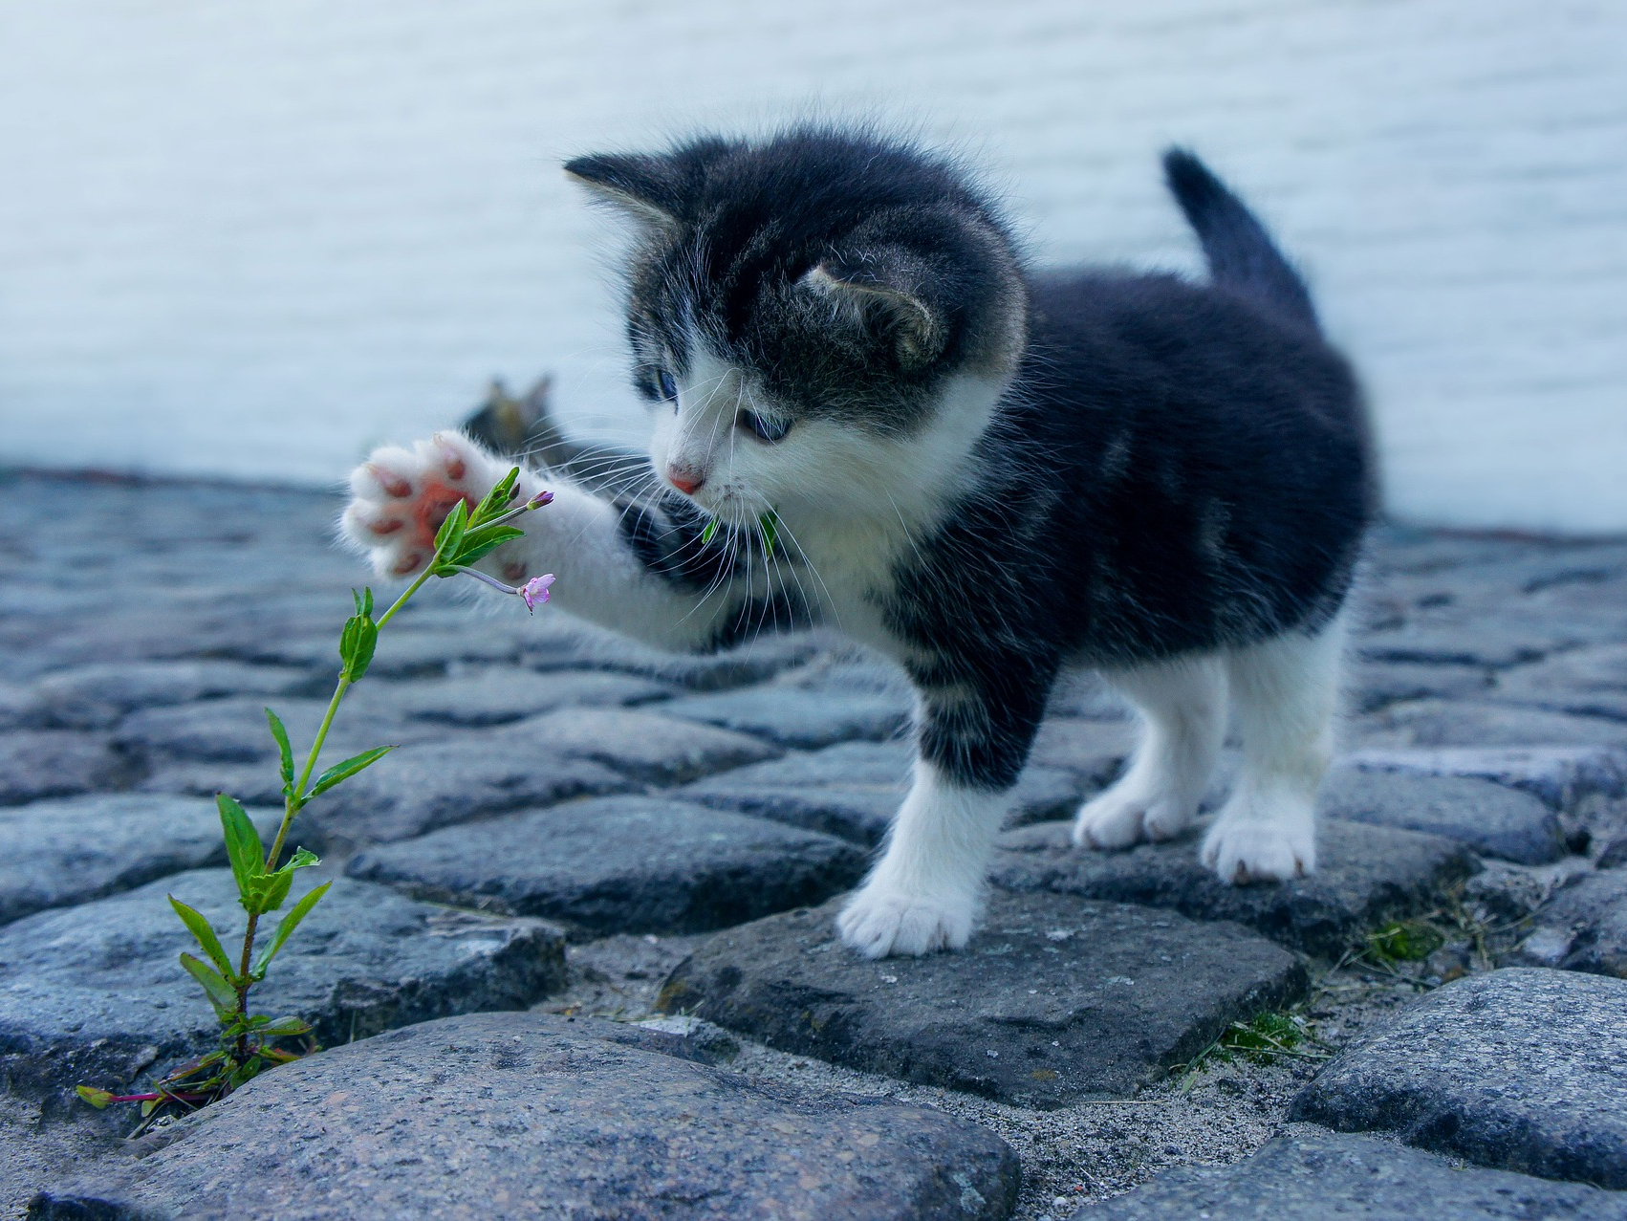
Emotional
Resilience
3. Close your eyes and remember a truly happy time in your life… winning a competition, getting a good grade on your test, family vacation, time spent friends…
Notes:
All right, what we're just feeling there is working on our emotional resilience, which means you have the ability to provoke powerful, positive emotions like curiosity or love, which we feel when thinking about the people we love when you need them most. Here's a secret from the scientific literature for you. If you can manage to experience three positive emotions for every one negative emotion over the course of an hour, a day, a week, you dramatically improve your health and your ability to successfully tackle any problem you're facing. And this is called the three-to-one positive emotion ratio. My favorite though is to do a Random Act of Kindness. RAOKs actually have been shown to make you happier for 2 weeks after doing one and make the other person happy for a whole day.

Slide 13
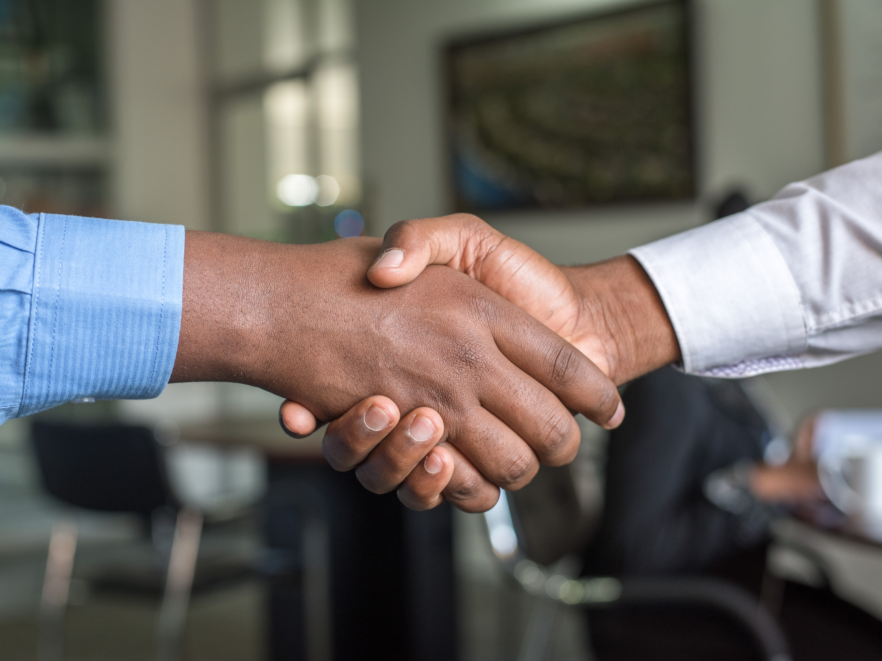
Social
Resilience
4. Look someone in the eye and shake their hand for six seconds
Notes:
All right, what we're just feeling there is working on our emotional resilience, which means you have the ability to provoke powerful, positive emotions like curiosity or love, which we feel when thinking about the people we love when you need them most. Here's a secret from the scientific literature for you. If you can manage to experience three positive emotions for every one negative emotion over the course of an hour, a day, a week, you dramatically improve your health and your ability to successfully tackle any problem you're facing. And this is called the three-to-one positive emotion ratio. My favorite though is to do a Random Act of Kindness. RAOKs actually have been shown to make you happier for 2 weeks after doing one and make the other person happy for a whole day.

Slide 14
Resilience helps you live longer!
Physical
Example: Never sit still for more than an hour
Mental
Example: Tackle tiny goals to boost your willpower
Emotional
Example: Achieve the 3:1 positive emotion ratio
Social
Example: Reaching out to 1 person you care about everyday
Notes:
In a TED Talk, Jane McGonigal described four types of resilience. In relating these descriptions, she said that people who practice these behaviors regularly live longer than those who don’t.
Here are the types:
Physical resilience- you are physically resilient if you don’t sit still longer than an hour at a time. You keep moving, especially when you don’t feel like it. I don’t know about you, but as I age, the temptation to sit on the couch or to nurse a pain by not moving is high. A physically resilient person works out the kinks and makes physical activity a priority.
Mental resilience- you are mentally resilient if you test your brain. Do puzzles. Play board games. Try new hobbies. Read new books. Stay engaged in work. Grow a garden. In short, mentally resilient folks stay challenged.
Emotional resilience-you are emotionally resilient if you engage in regular reflection on things beautiful, fanciful, visionary. Emotional resilience exercises our capability to imagine, dream, plan and create. It fortifies the soul. Emotional resilience allows us to find positive things even when circumstances stay grim.
Social resilience. When you stay in touch with others socially, you are being socially resilient. Hugs and handshakes stimulate the brain. Having a friend who you look forward to visiting with and taking the initiative to stay engaged is social resilience.

Slide 15
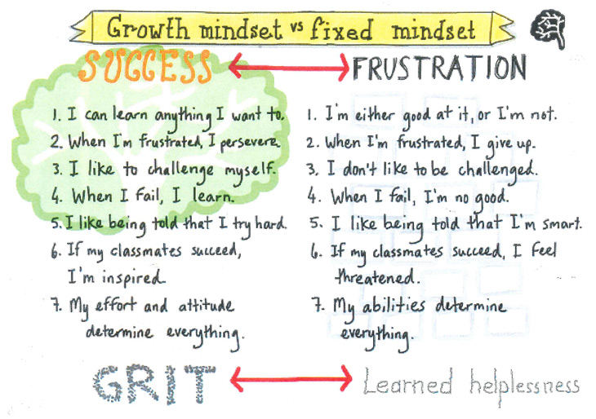

Slide 16
Ways To Build Your Resilience
Show up as your real self
Develop quality relationships
Spend face-to-face time with loved ones
Practice gratitude daily
Gain perspective by stepping out of your own box

Slide 17
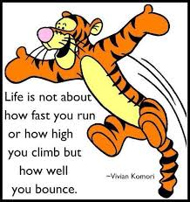
Become More Resilient!

Slide 18
Want to Become Part of the Movement?
Text bounceback to: 833-956-0928
Like us on Facebook:
Bounce Back Project
Check out our web pages: www.bouncebackproject.org
Sign up for newsletter: https://bit.ly/3wVS3zo

